Slide 1
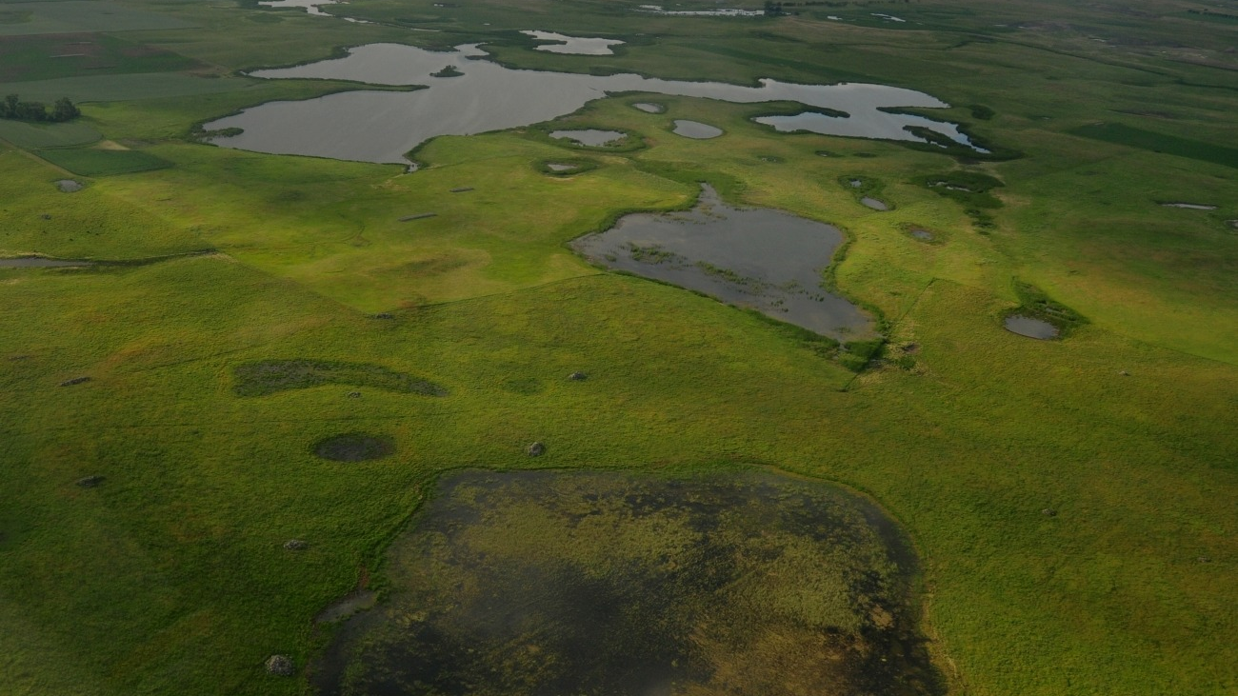

USACE / CWA Section 404
Why We Are Pursuing A Jurisdictional Determination (JD)
Hermosa, South Dakota
Prepared by: Daniel Fife • 02/17/2026
Notes:
[Sources]
- https://www.fws.gov/media/prairie-pothole-wetlands (background photo; public domain)
- https://en.wikipedia.org/wiki/File:United_States_Army_Corps_of_Engineers_logo.svg (USACE logo; public domain)
[/Sources]

Slide 2

Executive summary
Why request a JD for a project in Hermosa, SD
The JD is about regulatory certainty before we commit to design, grading, or construction.
Confirm whether any wetlands/streams on or near the site are “waters of the United States” (WOTUS) under Clean Water Act (CWA) Section 404.
Define the geographic limits of any jurisdictional aquatic resources so the site plan can avoid/minimize impacts early.
Reduce the risk of an unauthorized discharge of dredged/fill material (and associated enforcement, redesign, or stop‑work risk).
Streamline the permitting path: if impacts are unavoidable, the JD supports the right permit strategy (e.g., Nationwide vs. Individual).
Provide a defensible document for partners (lenders, buyers, contractors) and for long‑term project records.
Outcome:
Clear “yes/no + where” on USACE jurisdiction for the site review area.
Working objective: decide early, design smart, avoid surprises.
Notes:
[Sources]
- https://rrs.usace.army.mil/rrs/home/jurisdiction (JD definition and relationship to permitting)
- https://www.spl.usace.army.mil/Missions/Regulatory/Jurisdictional-Determination/Section-404-of-the-Clean-Water-Act/ (CWA Section 404 scope)
[/Sources]

Slide 3
What is a Jurisdictional Determination?
USACE document that answers: “Is it WOTUS, and where?”
Core concept
Why I’m targeting an AJD
A JD is a written USACE determination about whether a wetland and/or waterbody is subject to federal regulatory jurisdiction under CWA Section 404 (i.e., whether it is WOTUS).
It is the most defensible “yes/no + limits” record for jurisdiction on the property.
It can be relied on for a defined period (commonly 5 years), which supports financing and long project timelines.
If we disagree with the determination, there is a formal appeal path.
Two common JD types
Approved JD (AJD)
Important nuance
Definitive determination of presence/absence of jurisdictional waters and their limits. Typically valid for 5 years; appealable via USACE administrative appeal process.
A JD does not authorize impacts. If the project discharges dredged/fill material into WOTUS, a Section 404 permit may still be required.
Preliminary JD (PJD)
But it answers the critical first question: “Are we even in the federal program, and where are the boundaries?”
Assumes waters are jurisdictional for permitting efficiency (shorter path), without a definitive jurisdiction call.
JD = jurisdiction clarity. Permits = impact authorization.
Notes:
[Sources]
- https://rrs.usace.army.mil/rrs/home/jurisdiction (JD definition; JD not required to obtain a permit)
- https://www.nap.usace.army.mil/Missions/Regulatory/Jurisdictional-Determinations/ (AJD definition, 5-year validity, appeal reference)
- https://www.nae.usace.army.mil/Portals/74/docs/regulatory/Outreach/MA-NWPR-JurisdictionalDetermination.pdf (AJD duration noted as 5 years)
- https://www.spl.usace.army.mil/Missions/Regulatory/Jurisdictional-Determination/Section-404-of-the-Clean-Water-Act/ (Section 404 authorization concept)
[/Sources]

Slide 4
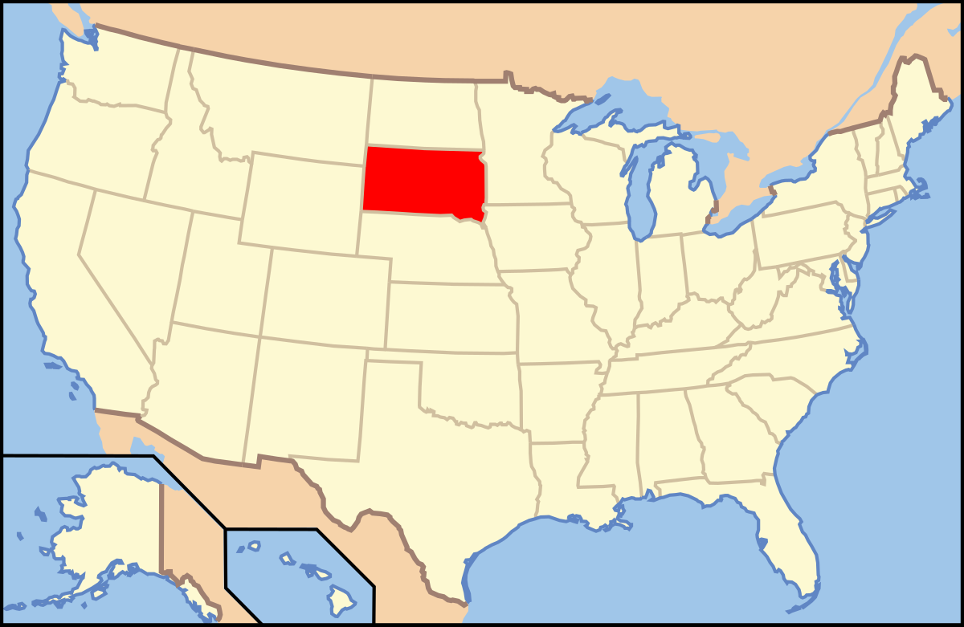
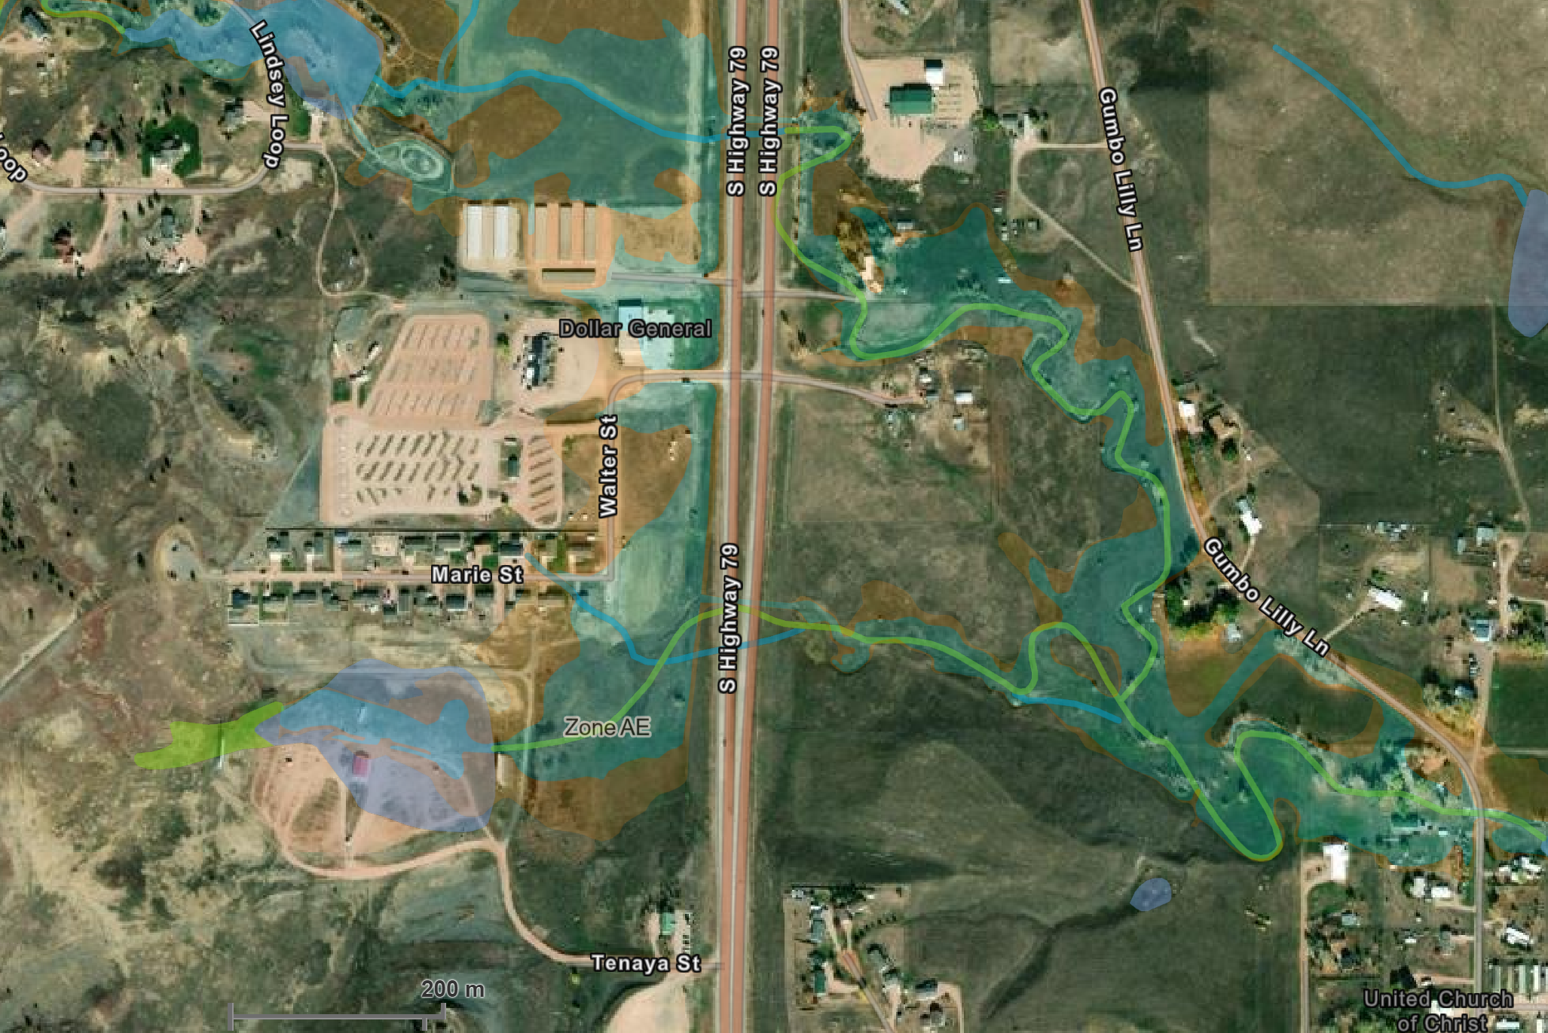
Site context: Hermosa, South Dakota
A JD is specific to the “review area” around the proposed activity
Where we are
JD review area (conceptual)
South Dakota
Hermosa is a town in Custer County near the Black Hills.
Hermosa
A JD evaluates aquatic features within the “review area” tied to the proposed activity (not just the property boundary).
Location is shown for context; the JD will be based on surveyed features and field verification.
Notes:
[Sources]
- https://en.wikipedia.org/wiki/Hermosa,_South_Dakota (Hermosa location and county)
- https://commons.wikimedia.org/wiki/File:Blank_map_subdivisions_South_Dakota.svg (South Dakota outline map; CC0)
- https://commons.wikimedia.org/wiki/File:Map_of_USA_SD.svg (USA map highlighting South Dakota)
[/Sources]

Slide 5
Why now: shifting WOTUS boundaries
JD provides site-specific clarity in a changing legal/regulatory landscape
Recent drivers of uncertainty
Legal baseline
What the JD resolves
In Sackett v. EPA (2023), the Supreme Court limited federal CWA coverage of “adjacent wetlands” to those with a continuous surface connection to covered waters (i.e., no clear demarcation).
That narrowing has downstream effects on which wetlands/streams are regulated — especially in headwater and intermittent systems.
Whether aquatic features in the review area are jurisdictional under the current interpretation of WOTUS.
Where the jurisdictional boundaries are on the ground (mapped and described).
A documented record that can be used to scope (or avoid) Section 404 permitting.
Practical implication
We should lock down a site-specific jurisdiction call before spending heavily on design, earthwork, or utility layout.
Bottom line
A JD converts “regulatory ambiguity” into a concrete design constraint (or green light).
This deck is informational and not legal advice.
Notes:
[Sources]
- https://www.supremecourt.gov/opinions/22pdf/21-454_4g15.pdf (Sackett v. EPA (2023) opinion)
- https://supreme.justia.com/cases/federal/us/598/21-454/ (Sackett summary)
[/Sources]

Slide 6
Benefits of pursuing a JD (before ground disturbance)
What this buys us in the project decision chain
Compliance risk ↓
Design optimization
Schedule certainty
Avoid accidental impacts to jurisdictional waters and associated enforcement or stop‑work risk.
Use mapped boundaries to shift pads, roads, and utilities to avoid/minimize impacts early.
De‑risk late redesigns by establishing the correct federal pathway up front.
Permit strategy clarity
Partner confidence
Cleaner records
If impacts remain, the JD supports the right permit type and mitigation planning.
A defensible determination helps lenders, buyers, and contractors price and plan realistically.
Creates a durable environmental baseline for the project file and future transactions.
JD is a decision-support tool: it shifts risk left (earlier) where changes are cheapest.
Notes:
[Sources]
- https://rrs.usace.army.mil/rrs/home/jurisdiction (JD purpose and role)
- https://www.epa.gov/cwa-404/permit-program-under-cwa-section-404 (Section 404 program overview)
[/Sources]

Slide 7
How we get an AJD (high-level workflow)
The Corps can also evaluate jurisdiction during permit review, but an AJD front-loads clarity
Typical sequence
1
Submit JD request
Provide maps, site plan, and any prior delineation. Most requests can be submitted via USACE’s Regulatory Request System (RRS).
2
Desktop + coordination
USACE reviews available data (aerials, soils, hydrology) and confirms the review area and field needs.
3
Field verification
Site visit (often with consultant support) to verify wetlands/waters and delineation flags.
4
USACE issues AJD
Written determination with maps/figures that identify whether jurisdictional waters are present and their limits.
5
Design + permitting decisions
Avoid/minimize impacts. If impacts remain, determine 404 permit pathway and mitigation needs.
Note: USACE states a JD is not required to apply for or obtain a permit; jurisdiction is evaluated as part of permit review. We are requesting an AJD to de-risk early decisions.
Submission channel: Regulatory Request System (RRS) or directly through the Omaha District SD Regulatory Office.
Notes:
[Sources]
- https://www.usace.army.mil/Missions/Civil-Works/Regulatory-Program-and-Permits/Regulatory-Program-Forms/ (RRS and forms guidance)
- https://www.usace.army.mil/Portals/2/RRS%20Fact%20Sheet%20%28External%29_20240509%20%281%29_1.pdf (RRS fact sheet)
- https://rrs.usace.army.mil/rrs/home/jurisdiction (JD definition; JD not required for permit)
[/Sources]

Slide 8
What I will provide to support the JD request
Make it easy for USACE to review and verify
Inputs that typically strengthen a JD request
Project definition
Technical support
Clear description of the proposed activity and review area (maps + narrative).
Current site plan / concept layout (pads, roads, utilities, crossings).
Aerial imagery and parcel boundaries; access notes for field visit.
Existing environmental reports (if any) and photos of drainages/wet spots.
Optional but helpful: a consultant wetland/waters delineation for USACE verification.
Soils/hydrology references (NRCS soils, topo contours, culverts, flow paths).
Any known prior permits, determinations, or agency correspondence for the parcel.
Point of contact list (landowner, consultant, surveyor, contractor).
If we provide a delineation up front, USACE can focus on verification instead of starting from scratch.
Notes:
[Sources]
- https://www.epa.gov/cwa-404/what-jurisdictional-delineation-under-cwa-section-404 (EPA overview of jurisdictional delineations and verification)
- https://www.usace.army.mil/Missions/Civil-Works/Regulatory-Program-and-Permits/Regulatory-Program-Forms/ (submission pathways including RRS)
[/Sources]

Slide 9
Who we coordinate with
Hermosa is within USACE Omaha District’s South Dakota Regulatory program
Primary touchpoints
USACE Omaha District — South Dakota Regulatory Office (Permits/JDs)
Project team: landowner, engineer, surveyor, environmental consultant
Potential coordination: EPA (CWA), state/local permitting agencies (as applicable)
USACE Omaha District
South Dakota Regulatory Office (Permits)
Phone: (605) 224‑8531
Preferred submission: USACE Regulatory Request System (RRS)
Next-step checklist (actionable)
Finalize the review area and gather base mapping (survey + aerial + concept plan).
Decide whether to retain a consultant for a delineation to speed verification.
Submit an AJD request via RRS (or coordinate directly with the SD Regulatory Office).
Schedule field verification; incorporate results into design and permitting decisions.
Goal: complete the jurisdiction call before final civil design and bid-ready construction plans.
Notes:
[Sources]
- https://www.nwo.usace.army.mil/Locations/District-Offices/South-Dakota/ (Omaha District SD Regulatory Office phone)
- https://rrs.usace.army.mil/rrs/home/regulatory-program (RRS overview; JD request option)
- https://www.usace.army.mil/Media/News/NewsSearch/Article/4311321/usace-introduces-new-regulatory-request-system-module/ (RRS capabilities and JD submissions)
[/Sources]

Slide 10
Appendix: key terms & references
Quick definitions used in this deck
Key terms
WOTUS
“Waters of the United States” — the set of waters and wetlands covered by the Clean Water Act’s federal jurisdiction.
CWA §404
Regulates discharges of dredged or fill material into WOTUS; administered by USACE (with EPA oversight).
JD / AJD
A (Approved) Jurisdictional Determination is USACE’s written, site-specific finding about whether WOTUS are present and the limits of jurisdiction.
Delineation
Field identification and mapping of wetlands/waters indicators for USACE verification and JD/permit decisions.
Primary references used:
USACE RRS (Jurisdiction); USACE Section 404 overview; Sackett v. EPA (2023); Omaha District SD Regulatory contacts; EPA Section 404 pages.
End of deck
Notes:
[Sources]
- https://rrs.usace.army.mil/rrs/home/jurisdiction (JD definition)
- https://www.spl.usace.army.mil/Missions/Regulatory/Jurisdictional-Determination/Section-404-of-the-Clean-Water-Act/ (Section 404 description)
- https://www.supremecourt.gov/opinions/22pdf/21-454_4g15.pdf (Sackett v. EPA (2023))
- https://www.epa.gov/cwa-404/permit-program-under-cwa-section-404 (EPA Section 404 program overview)
[/Sources]

