Slide 1

Open Meetings Presentation
Dated 2/3/26
Scott James
Town Attorney

Slide 2
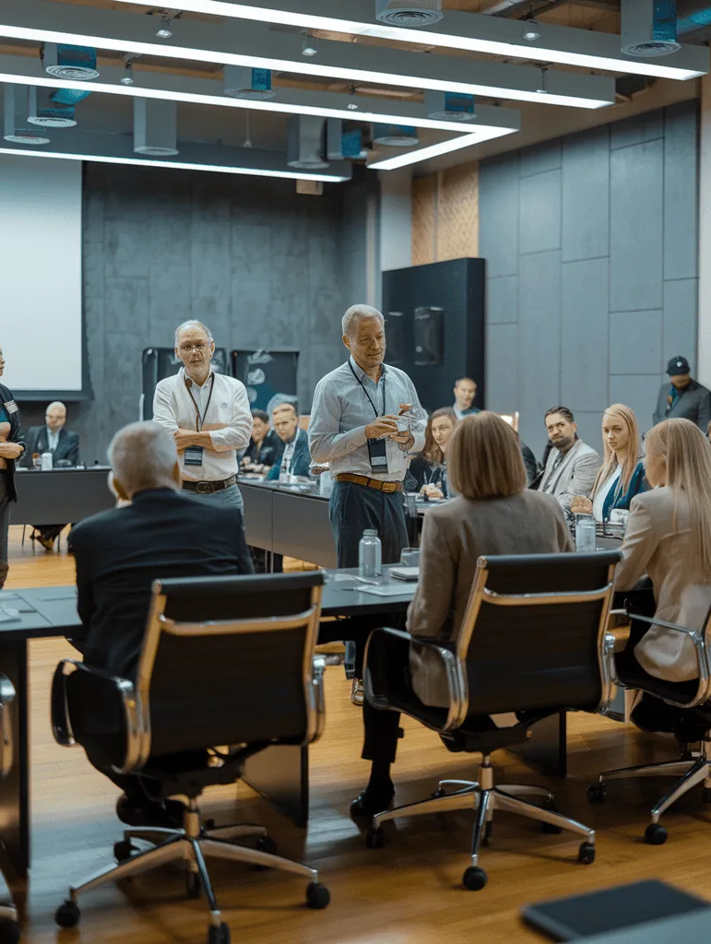
Basic Rule
SDCL 1-25-1
  All official meetings of any public body are open to the public unless a specific law is cited to close the meeting.

Slide 3

Purpose
“…to prohibit actions being taken at secret meetings where it is impossible for the interested public to become fully informed and to detect improper influences.”
  Olson v. Cass, 349 N.W.2d 435 (S.D. 1984)

Slide 4
OFFICIAL ?
An official meeting is:
“Any meeting of a quorum of a public body at which official business or public policy of that public body is discussed or decided … whether in person or by means of teleconference or electronic means.”
SDCL 1-25-12(1)

Slide 5
OFFICIAL meeting?
Need for an official meeting:
Quorum
Discussion/decision -- official business or public policy

Slide 6
Example 1
Meeting for a 7 person board is scheduled to being at 7PM, but 4 members show up 40 minutes early. They begin to talk about the local High School football team’s recent game and how well they played.
Allowed or Not?
One member before 7 PM starts suggesting that the board could help pay for improvements to the bleachers with some funds available.
Allowed or Not?

Slide 7
Official Meeting
Regular meetings of the body… But, what about?
    Lunches
    Sporting events
    Social events
    Email discussions?

Slide 8
OFFICIAL MEETING
Email Discussions?
  Definition of an official meeting specifically recognizes “electronic means” which is defined to include:
    E-mail
    Instant messaging
    Social media
    Text messaging
    Virtual meeting platforms
        SDCL 1-25-12(1)
  Communications for scheduling purposes are excluded

Slide 9

Email/text violations
Example 1: The "Reply All" Chain (Direct Quorum)
This is the most obvious violation, where a majority of the board (a quorum) is simultaneously involved in an email discussion.
Scenario: A 5-member city council (3 members make a quorum) is debating a new zoning policy.
Email 1 (Councilmember A to all): "I think we should approve the new zoning proposal. It will increase revenue."
Email 2 (Councilmember B to all): "I agree with A. The proposal looks good, but maybe we should reduce the proposed height limit by 10 feet."
Email 3 (Councilmember C to all): "I support both A and B. Let's make that change to 10 feet and vote for it on Tuesday."
Result: A quorum (3/5) has deliberated and reached a consensus via email, bypassing the required public meeting.

Slide 10
Email/text violations
Example 2: The "Hub and Spoke" (Indirect Serial Meeting)
This is a more subtle violation where one person (the "hub") communicates with several others (the "spokes") individually, passing information along until a quorum has discussed it.
Email 1 (Member A to Member B): "I’m not sure about the budget proposal. I think we should cut the education funding."
Email 2 (Member B to Member C): "Just spoke with A, they want to cut education funding. I think I agree."
Email 3 (Member C to Member D): "B and A are leaning toward cutting education funding. We should probably do that."
Result: Even though no single email chain included a quorum, A, B, C, and D (a majority) have collectively deliberated on public business, constituting a serial meeting.

Slide 11
Email/text violations
. Example 3: The "Draft Document" Chain
Scenario: A board director places a draft policy on a shared document site (like SharePoint or Google Docs) and invites all board members to edit and comment.
Action: Three or more members (a quorum) use the comment/chat function within the document to deliberate on the wording before the meeting.
Result: The "passive receipt" threshold is crossed, turning the collaborative tool into a prohibited serial meeting

Slide 12
Email/text violations
Example 4: Social Media/Text Message Chain
Scenario: A board member posts a plan to vote against a project on Twitter/X.
Activity: Another member retweets it in opposition, tagging two other members. A third member responds supporting the opposition.
Result: This interactive, public-facing, but un-noticed, conversation among a quorum constitutes a violation

Slide 13
Official Meeting -- Exceptions
All found in SDCL 1-25-1
1. Meeting with other bodies
“provide information or attend the official meeting of another [body]…”
2nd body must meet the notice requirements of Ch. 1-25

Slide 14
Official Meeting -- EXCEPTIONS
2. Attending a press conference “called by a representative of the public body.”
3. Event by Non-gov’t entity where the public body does not control the agenda
Must post “notice of agenda” to include date, time, and location
must meet posting requirements of SDCL ch. 1-25

Slide 15
Official meeting -- Exceptions
4. Quorum of “township supervisors, road district trustees, or trustees for a [3rd class municipality] who meet solely for the purpose of:”
    Implementing previously adopted public policy,
    Carrying out ministerial functions, or
    Undertaking factual investigations of conditions related to public safety.

Slide 16
Committees/Task Forces
Must follow open meetings rules if created by statute, ordinance, or resolution and have authority to exercise “sovereign power.”
  SDCL 1-25-12(2)
If not one of the above, then not a public body bound by open meeting statutes, and then…
  Final recommendation, finding, or report SHALL be reported in open meeting of the governing body.
  Governing body MUST DELAY final action until next meeting. SDCL 1-27-1.18
  Encouraged to comply with open meetings requirements

Slide 17
Quiz: Is This an Open Meeting?
Three council members exchange texts reacting to a citizen complaint – no vote taken. Open meeting?
A quorum attends a nonprofit luncheon where city issues are discussed informally.
A committee without statutory authority makes a final recommendation by email.

Slide 18

Public Notice
SDCL 1-25-1.1 -- Political Subdivisions
  Must Provide:
      Notice of the meeting, including a proposed agenda
      Must state the date, time and location of the meeting
  Must Be:
      Visible to the public, readable, and in an accessible location
      At least “an entire, continuous twenty-four hours immediately preceding” the meeting
      Posted at the principal office of the public body
  Must also be posted on website if website exists

Slide 19

Public Notice
Special or rescheduled meetings
Notice requirements the same “to the extent that circumstances permit” SDCL 1-25-1.1
Notice must be delivered by mail, email, or in person to news media who have requested notice
Must make an honest effort
Remember: must comply with any other requirements of state code?
Special publication or other notice requirements elsewhere in state law

Slide 20
Printed Materials
SDCL 1-27-1.16
  Must be made available to the public when provided to the members of the body or at least 24 hrs prior to the meeting
      Posted on the website
      Made available at principal place of business
  If not posted on website: at least ONE copy must be in the meeting room
  Not required for exempt material
      Attorney-client or Executive Session materials

Slide 21
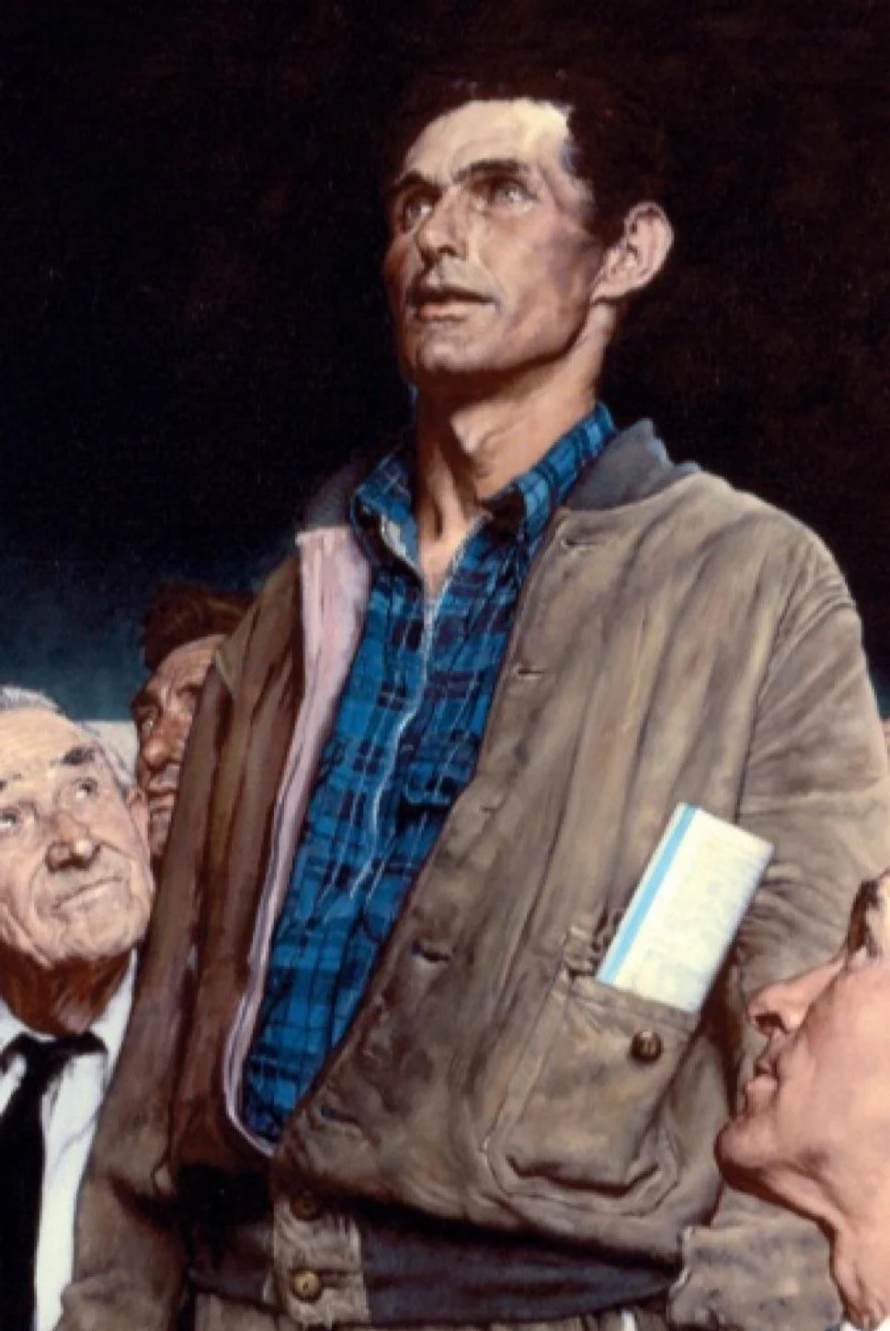
PUBLIC COMMENT
SDCL 1-25-1
Must allow public comment at every official meeting
Limited at the public body’s discretion re: time allowed for each topic and the total time allowed for public comment
Not Required for official meetings held solely for certain purposes – i.e. executive session, inauguration or swearing in, presentation of annual report

Slide 22
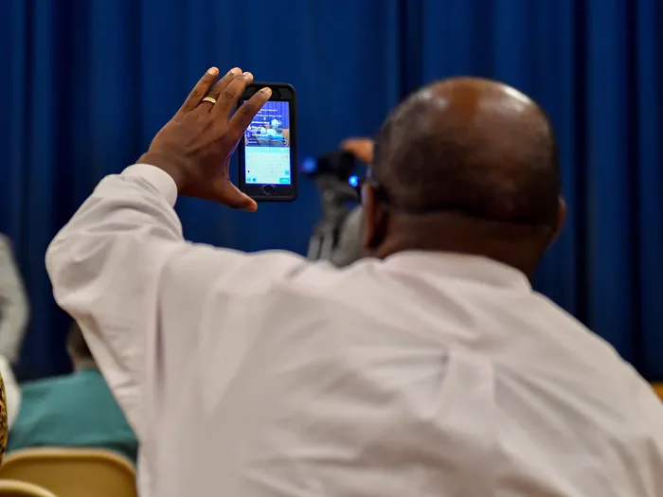
Public Recording
SDCL 1-25-11
  The public is allowed to audio or video record a public meeting as long as
      Reasonable
      Obvious
      Not disruptive
Example: Local Newspaper wants to set up a camera at beginning of meeting and pick up at end of meeting because they “don’t have time to sit through meeting” Allowed?

Slide 23
Executive Session
SDCL 1-25-2
May be held for the purpose of discussing:
Public officer or employee competence or qualifications
Student discipline or eligibility for programs or activities
Communications with attorney, or reviewing communications related to proposed or pending litigation or contract matters
Preparing for or conducting labor negotiations
Marketing strategies of government owned business
Information relating to the protection of public or private property and any person on that property.
Very specific subsections

Slide 24
Executive Session
    Not limited to only the 6 listed subsections
  “Nothing in 1-25-1 or this section prevents an executive or closed meeting if the federal or state Constitution or the federal or state statutes require or permit.” SDCL 1-25-2
    Covers other grants of confidentiality or privilege found in state or federal law
          attorney/client privilege
          economic development information (SDCL 9-34-19)
          Confidential medical or mental health information

Slide 25

Executive Session
Motion, second, and majority vote of those present to enter
Purpose and legal citation must be stated in the closure motion.
NO official action can be taken in executive session
Official action may only be taken upon return to open session
NO discussions of any other matters other than those cited in the closure motion

Slide 26
Teleconferences
Teleconference: information exchanged by audio, video, or electronic medium – including the internet
SDCL 1-25-12(5)
Member is present if answers present during roll call
Votes may be taken by voice vote unless a member votes in the negative – then vote must proceed via roll call

Slide 27

Teleconferences
Notice Requirements
  Posting and Agenda Requirements are the SAME
  Allow “one or more places” for the public to listen and participate.
        SDCL 1-25-1.6
  If less than a quorum of members present at the location for public participation, then must provide public the opportunity to listen via telephone or internet
  Does not apply to executive or closed meetings

Slide 28
Executive Session Challenge
Board enters executive session to discuss litigation strategy.
While closed, members begin discussing future zoning changes.
What went wrong? What should have happened instead?

Slide 29

Meeting Minutes
SDCL 9-18-1.1
  City Finance Officer responsible for keeping a record of the proceedings
9-18-1.1. Time for delivery of copy to official newspaper.
The finance officer shall maintain a record of the minutes published pursuant to § 9-18-1 and deliver a copy to the official newspaper within five business days from the date the meeting was held.

Slide 30
Annual Review Open Meetings Laws
All public bodies required to follow the open meetings laws in SDCL ch. 1-25 must annually review:
An explanation of the laws prepared by the Attorney General, and
Any other material pertaining to open meetings provided by the attorney general, and
Must report completion of the review in the minutes of the public body

Slide 31
State’s Attorney Enforcement
Under SDCL 1-25-6 and 1-25-6.1
State’s Attorney has 3 options:
  Charge Class 2 Misdemeanor
  Dismiss (“no merits” letter)
        Send copy of complaint and investigation file to AG
  Refer to Open Meeting Commission for further action
  IF conflict of interest with an alleged complaint against the board of county commissioners
      Refer to another SA
      Refer to AG only if no other conflict option available

Slide 32
Open Meetings Commission
5 State’s Attorneys or Deputy State’s Attorneys appointed by the Attorney General
Jurisdiction occurs only upon complaint referred by a State’s Attorney
No independent review of open meetings complaints
Jurisdiction only over violations of SDCL ch. 1-25
No investigative authority
Rely upon the record developed by the State’s Attorney and the parties

Slide 33
Open Meetings Commission
Procedure:
  State’s Attorney receives complaint and investigates
      Complaint must be notarized
  State’s Attorney makes referral to OMC
  Public Body given opportunity to respond
  Hearing scheduled and arguments heard
  Majority of OMC makes decision
  Written decision issued and filed with Attorney General

Slide 34
Open Meetings Commission
No right of appeal -- decision of the OMC is final
No statutory mechanism for reconsideration of OMC decision
If OMC finds a violation:
  Can only issue public reprimand
    Cannot impose fines or other penalties
    Cannot send back to State’s Attorney or to Attorney General for criminal prosecution
Final decision is a public record

Slide 35
Common Pitfalls – What Gets Public Bodies in Trouble- Per AG Office
Serial emails or texts that amount to discussion of official business
Failure to properly notice special or rescheduled meetings
Discussing topics in executive session beyond the stated citation
Taking 'consensus' or polling votes outside an open meeting
Insufficient or vague agenda descriptions

Slide 36

Hot Topic- Adding agenda Items without 24 hour public notice
In the Matter of Open Meetings Complaint v. Yankton County Board of Commissioners addressed this topic
May Agenda Items be added after the agenda has been sent out to the public and less than 24 hours before the meeting begins, or at the start of the meeting?

Slide 37
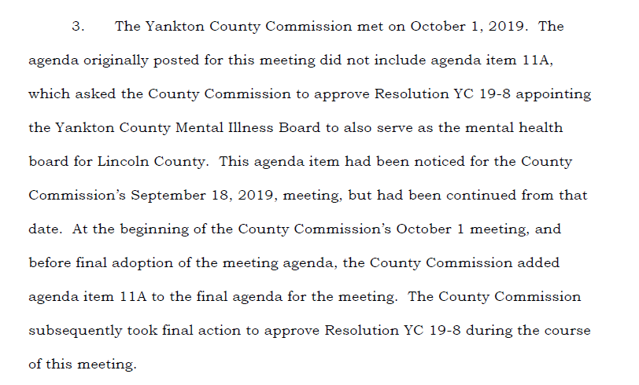

Slide 38
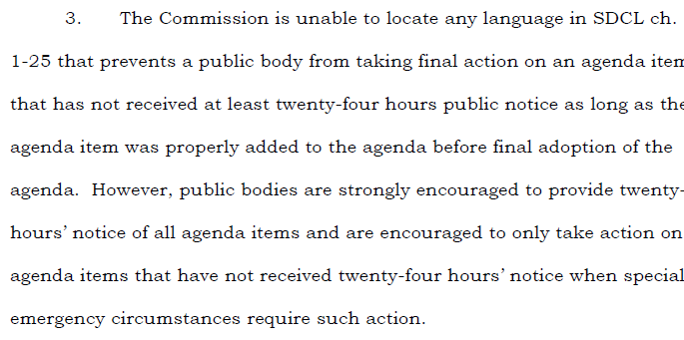
But…hold on a minute….

Slide 39

PREVIEW OF COMING ATTRACTIONS- NEW LAWS

Slide 41

QUESTIONS????

